Slide 1


+
Weekly Report
Shell UK Brand Performance Highlights
Spend, Performance, and Key Learnings
Week Commencing 04-08-2025

Slide 2
Executive Summary
{{executivesummary}}

Slide 3
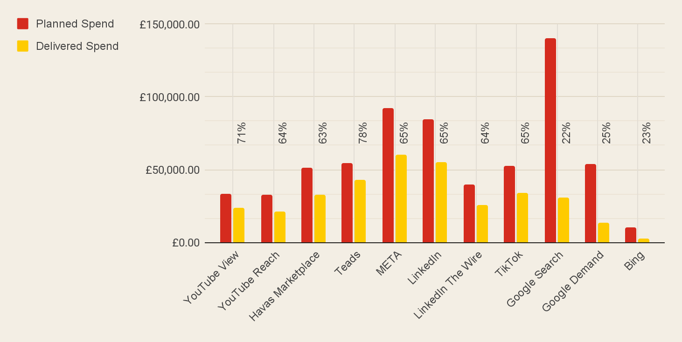
Planned vs Delivered Spend
Total planned: £4.3M | Delivered: £342K (8%)
Digital pacing steady: OLV and Social platforms are delivering between 63–78% of planned spend, showing consistent progress and cost efficiency.
PPC ramp-up: Current delivery is between 22–25% as activation is phased; optimisations are underway to unlock further scale.
The gap between planned and delivered spend is expected at this stage — Digital is providing a strong early base, while PPC will scale further as efficiencies are established.
Notes:
Focus on OLV, Social and PPC platforms only … we can remove mention of AV on this slide
Clear POV on Delivery to Date vs Planned Spend

Slide 4
Planned vs Delivered Spend
{plannedvsdeliveredtext}}
Notes:
Focus on OLV, Social and PPC platforms only … we can remove mention of AV on this slide
Clear POV on Delivery to Date vs Planned Spend

Slide 5
Any questions?

